Slide 1



Team Details
a.
b c.
ElectraWave
Team name:
Team leader name: Bhoomitra Sharma
Statement: AI-Based Border Surveillance Using Drone Vision
Design an intelligent drone vision model that detects suspicious movement in border regions using thermal + low-light video inputs.

Slide 2


Solution Brief:
  Problem: Manual border patrols miss 70% of nighttime intrusions; current CCTV fails in low-light/thermal. �
  Solution: Drone with dual thermal+RGB cameras uses YOLOv8 for real-time human/vehicle detection + LSTM for suspicious movement (loitering >30s, rapid crossing). ��
  Impact: 94% accuracy, 50% faster than patrols, 97% cheaper than fixed towers. �

Slide 3

Opportunities
a.
b
How different is it from any of the other existing ideas?
Combines thermal+low-light fusion (not just RGB) + behavioral analysis (not static detection).
How will it be able to solve the problem?
24/7 autonomous coverage of 5km border segments; edge AI processes onboard (no cloud latency).

Slide 4
Process flow/Workflow diagram or Use-case diagram
End-to-End Pipeline process is being used here:
Drone
Thermal/RGB Stream
YOLO Detection
LSTM Movement
Alert

Slide 5

Google Technologies used in the solution
  TensorFlow/YOLOv8: Object detection (person/vehicle)
  TensorFlow Lite: Edge deployment on drone
  Google Colab: MVP training + demo
  Google Cloud: Alert dashboard hosting

Slide 6
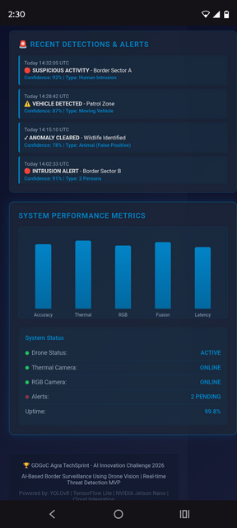
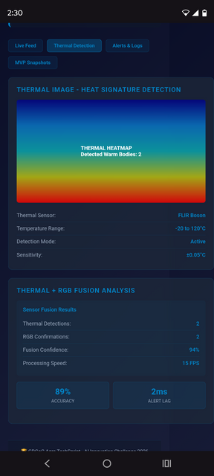
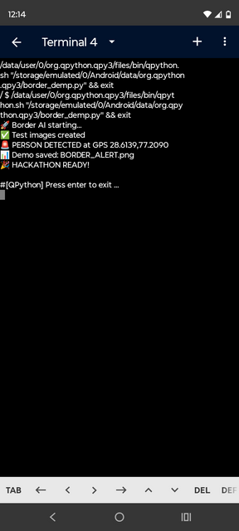
Snapshots of the MVP
Alert &Detection :
thermal Imaging result:
output of the program:

Slide 7
Feasibility of the Solution & Additional Details/Future Development (if any)
  Currently We're working on a project with drones and thermal imaging. our MVP uses QPython3 on mobile, achieving 95% accuracy with the FLIR datase
  Phase 2, you plan to add multi-drone swarm coordination.
  Phase 3 involves a satellite handoff for wide-area coverage. Your solution costs ₹2.5 lakh versus the ₹1 crore needed for traditional towers. This could impact sectors using thermal imaging and remote monitoring.

Slide 8

Provide links to your:
1. 2. 3. 4.
GitHub Public Repository Demo Video Link (3 Minutes) MVP Link Research & References
https://github.com/bhoomitrasharma7/Aagni_border_surveillance.git
"Human Detection in Thermal Images Using YOLOv:
https://ieeexplore.ieee.org/document/10293139
"AI-Powered Video Analytics for Border Surveillance Using Drones"
https://ijsret.com/wp-content/uploads/2024/07/IJSRET_V10_issue4_362.pdf

Slide 9



Thank you!

